Slide 1


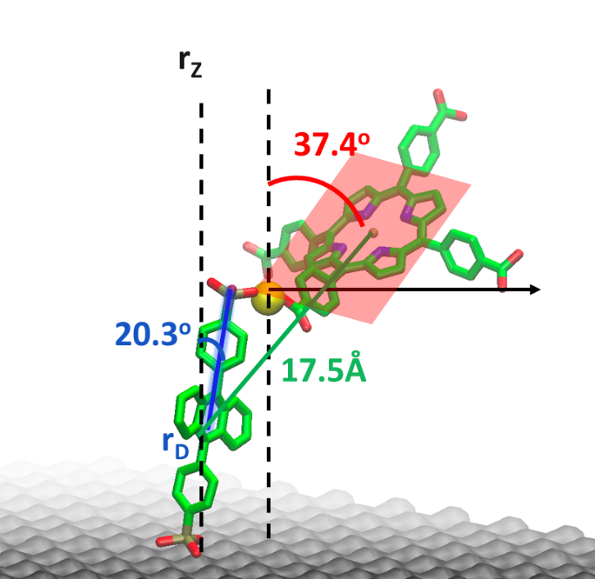
Understanding and Controlling Molecular Excited State Processes Using Metal Oxide Interfaces
Kenneth Hanson
Department of Chemistry & Biochemistry
Florida State University, Tallahassee, FL, USA

Slide 2
Molecular Photochemistry/Photophysics
phosphorescence
internal
conversion
fluorescence
intramolecular charge transfer
hν
conformational change
Molecule
electron transfer
photochemical transformation
proton transfer
exiplex formation
energy transfer
excimer formation

Slide 3
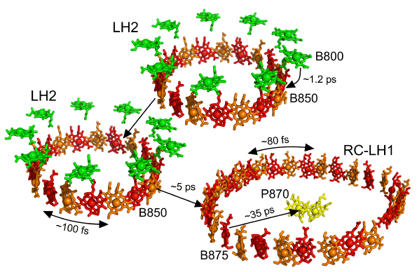
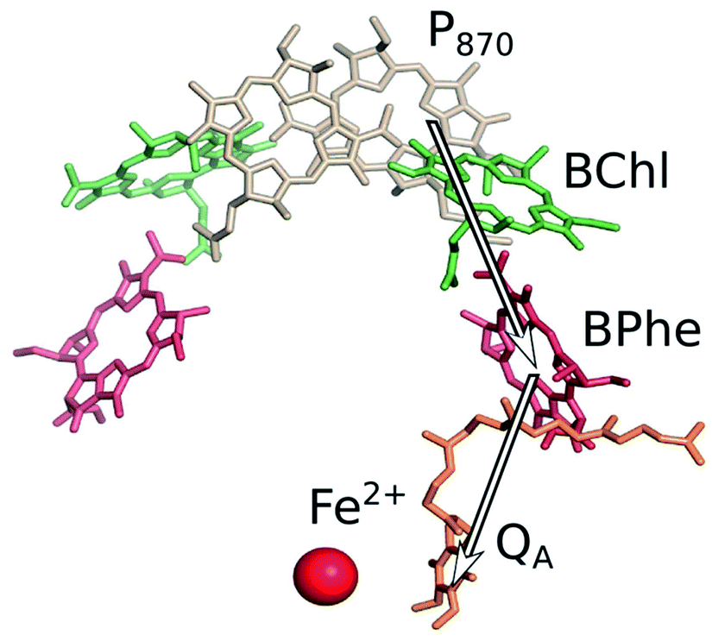
Molecular Photochemistry/Photophysics
Energy Transfer
Electron Transfer
Sundström et al. J. Phys. Chem. B 1999, 103, 2327-2346.
Lundholm et al. RSC Adv. 2014, 4, 25502-25509.

Slide 4
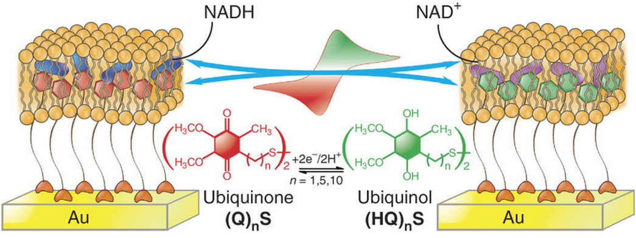
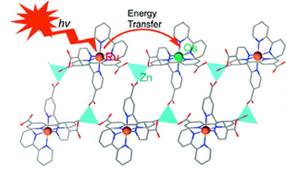
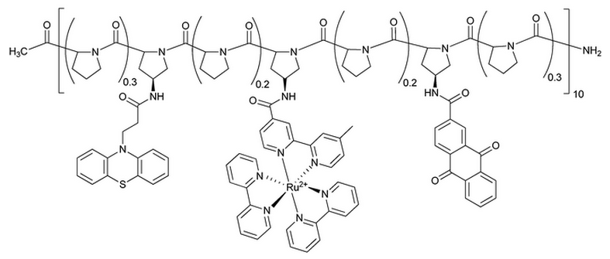
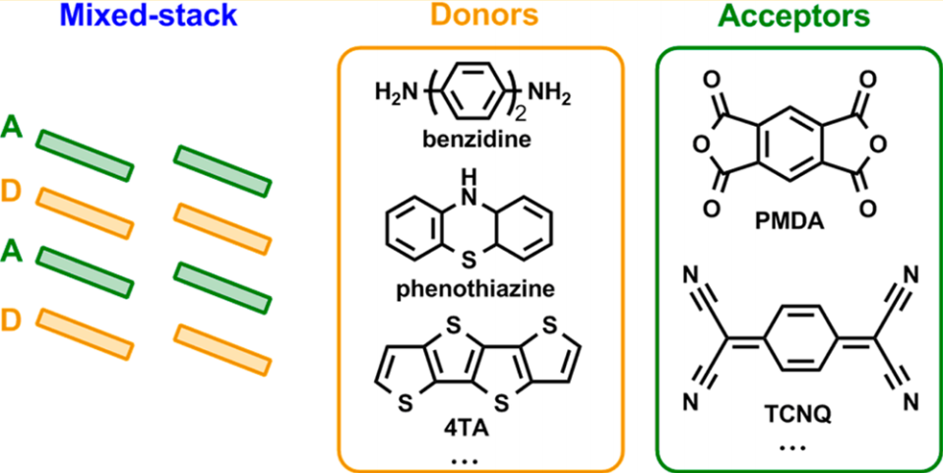
Structural Control: Humans
Phospholipid Bilayers
Metal Organic Frameworks
Ma et. al. Nature Protocols, 2013, 8, 439
Kent et. al. J. Am. Chem. Soc., 2010, 132, 12767
Polypeptides
Crystals
Slate et. al. J. Am. Chem. Soc., 1998, 120, 4885
Zhu et. al. J. Phys. Chem. C, 2014, 118, 14150

Slide 5

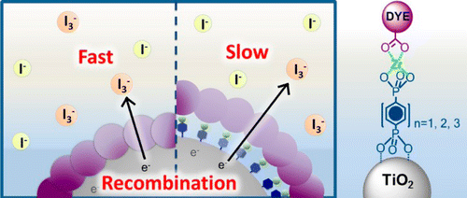
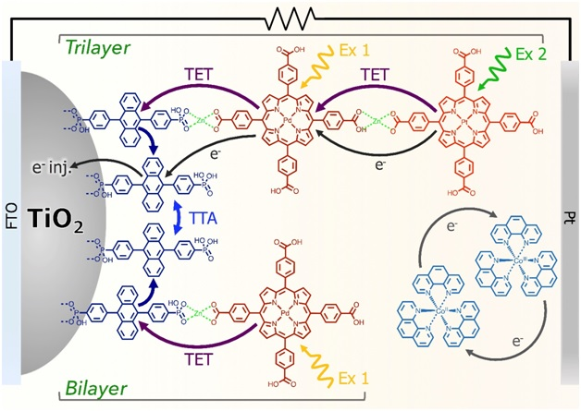
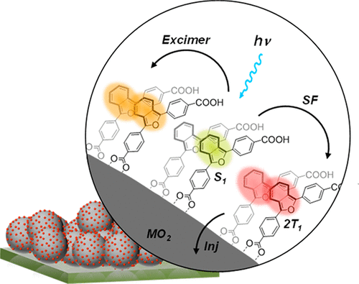
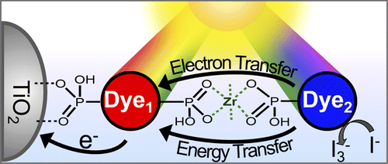
Metal Ion-Linked Multilayer
NanoMO₂
Control e⁻ Transfer
Photon Upconversion
Singlet Fission
Energy/e⁻ Cascade
5

Slide 6
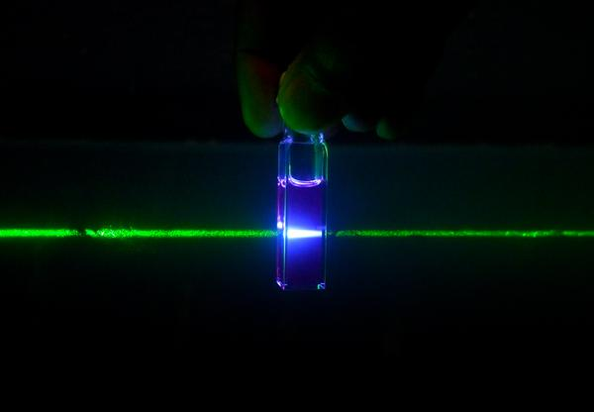
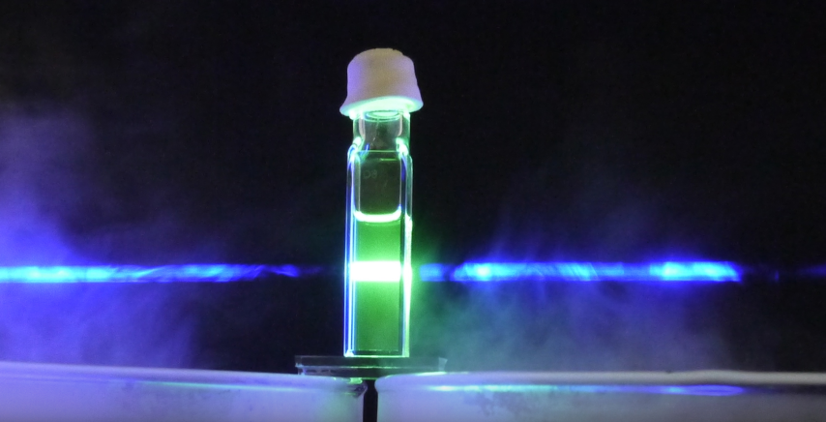
Down Conversion vs. Upconversion
S₃
S₂
IC
IC
S₁
hν_{ex}
hν_{em}
S₀
hν → hν
hν → hν

Slide 7
Photon Upconversion
S₁
S₁
(5)
S₁
S₁
(2)
(4)
T₁
T₁
T₁
T₁
(3)
(1)
hν
hν
S₀
S₀
Sensitizer
Annihilator
Annihilator
Sensitizer
2 hν → hν

Slide 8
Photon Upconversion
S₁
(5)
S₁
(4)
T₁
T₁
hν
S₀
Annihilator
Sensitizer
2 hν → hν

Slide 9
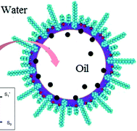
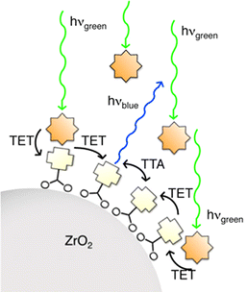
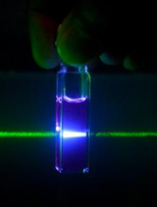
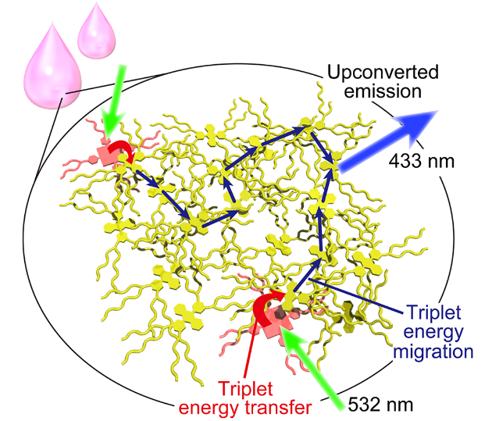
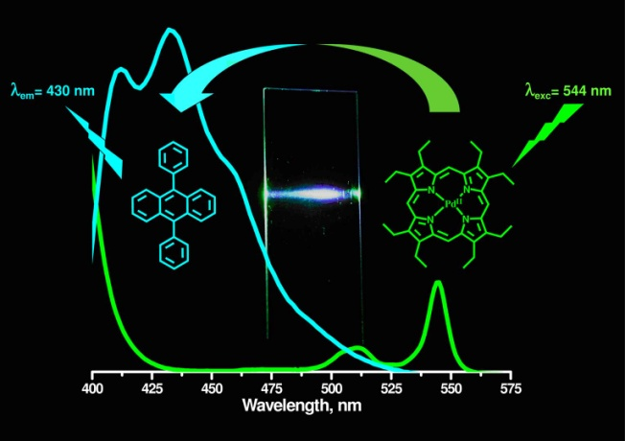
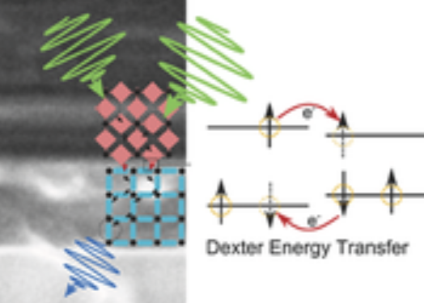
Sensitizer-Annihilator Interactions
Solution
Microemulsion
Heterogeneous
Chem. Commun., 2004, 2860
Photochem. Photobiol. Sci. 2014, 13, 48
J. Phys. Chem. C, 2013, 117, 14493
Polymer Films
Neat-solvent
MOF
JACS 2007, 129, 12652
JACS 2013, 135, 19056
JACS 2016, 138, 6541

Slide 10

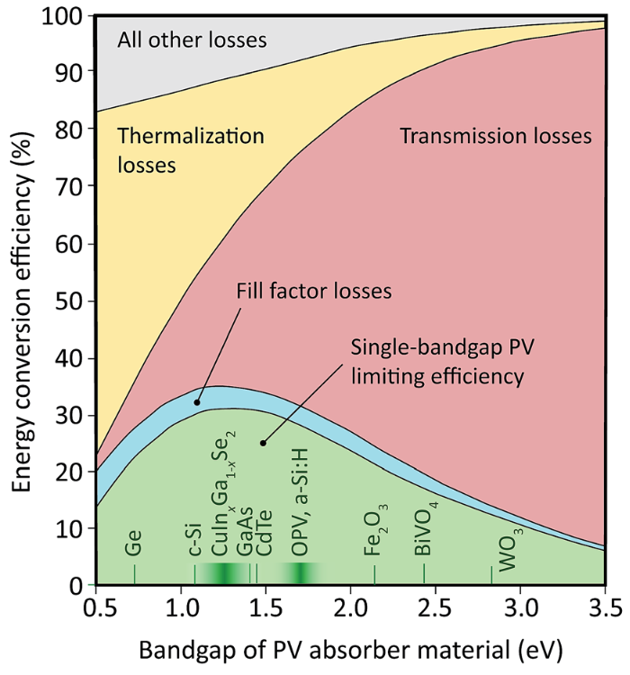
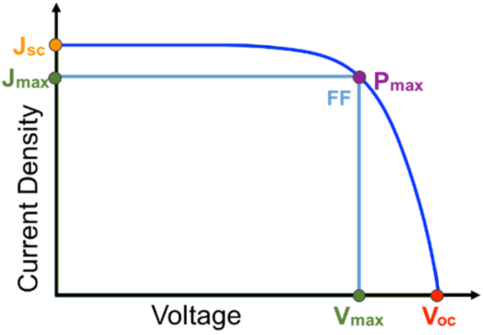
Solar Cell Efficiency
Schulze and Schmidt Energy Environ. Sci. 2015, 8, 103-125
P_{in} = 100 mW/cm² (AM1.5)
P_{max} = J x V
V_{oc}
SQ Limit
1.3 ev
Max Theoretical Efficiency
hν
hν
hν
hν
V_{oc}
Standard solar cell ~33%
1.3 eV bandgap
Large BG
High V, Low J
Small BG
Low V, High J

Slide 11
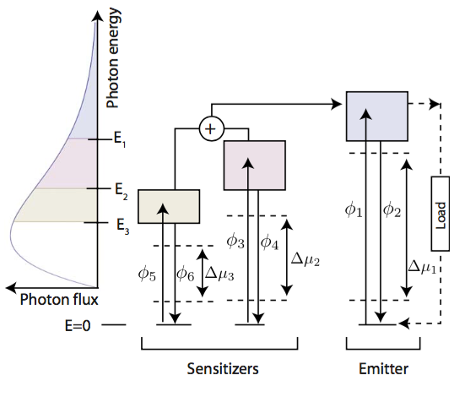
Solar Cell Efficiency
Schulze and Schmidt Energy Environ. Sci. 2015, 8, 103-125
Perovskites, OPV, DSSC
with TTA-UC
Max Theoretical Efficiency
Standard solar cell ~33%
1.3 eV bandgap
Solar cell with upconversion > 45%
Ekins-Daukes and Schmidt,
Appl. Phys. Lett., 2008 93, 063507.
1.76 eV bandgap

Slide 12
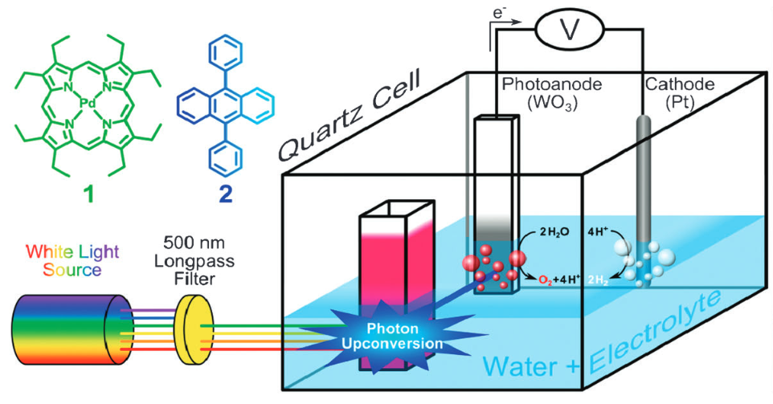
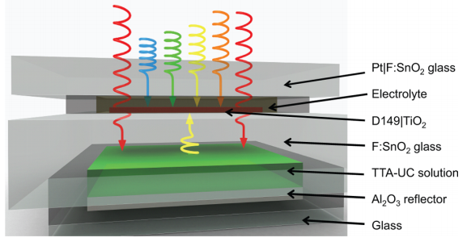
Harnessing TTA-UC
Optical Coupling:
(4)
(2)
Transmission
Light absorption and TTA
Upconverted emission
Absorption by a solar cell
hν
(3)
hν
S
A*
A
(1)
Solar Cell
Upconversion Solution/Film
Chem. Commun. 2012, 48, 209.
J. Phys. Chem. Lett. 2013, 4, 2073.

Slide 13
Harnessing TTA-UC
Optical Coupling:
(4)
(2)
Transmission
Light absorption and TTA
Upconverted emission
Absorption by a solar cell
hν
(3)
hν
S
A*
A
(1)
Solar Cell
Upconversion Solution/Film
Electronic Coupling:
(1)
(2)
hν
Light absorption and TTA
Photocurrent Generation
A*
e⁻
S
A
No isotropic emission
No self-absorption
Increase sensitizer concentration
Upconversion Solar Cell
Need A* at a charge separation interface!

Slide 14
Metal Ion-Linked Multilayer
NanoMO₂
S and A in proximity
A-A interactions
On a charge separation interface
Easy DSSC integration
Hill et al. J. Phys. Chem. Lett. 2015, 6, 4510.

Slide 15
Metal Ion-Linked Multilayer
NanoMO₂

Slide 16
TTA-UC Emission
λ_{ex} = 532 nm (1 W/cm²)
Φ = 0.0023
Hill et al. J. Phys. Chem. Lett. 2015, 6, 4510.

Slide 17


TTA-UC Emission
Weak TTA Limit
Strong TTA Limit
Slope = 2
Slope = 1
Castellano et al. J. Phys. Chem. Lett. 2012, 3, 299-303.
Hill et al. J. Phys. Chem. Lett. 2015, 6, 4510.

Slide 18
Mechanism
CB
e⁻
S₁
e⁻
S₁
S₁
CB
S₁
ISC
T₁
ISC
T₁
T₁
T₁
ET
hν
ET
hν
E
hν
e⁻
S₀
e⁻
S₀
S₀
S₀
D/D⁺
VB
A
Zn
S
VB
A
Zn
S
ZrO₂
TiO₂
Upconverted Emission!
Photocurrent?

Slide 19
TTA-UC Photocurrent
On ZrO₂: Upconverted Emission
ZrO₂-ML
λ_{ex} = 532 nm
MeCN
J. Phys. Chem. Lett. 2015, 6, 4510.
On TiO₂: Upconverted Photocurrent
TiO₂-ML
V
Co(bpy)₃^{2+/3+}
MeCN
Pt counter electrode

Slide 20
TTA-UC Photocurrent
J_{sc}/V_{oc} greater than the sum of its parts.
J_{sc}= 0.009 mA/cm²
Demonstrated an integrated TTA-UC solar cell.
η = 1.6 x 10⁻⁵ %
ACS Energy Lett. 2016, 1, 3-8.
On TiO₂: Upconverted Photocurrent
TiO₂-ML
V
Co(bpy)₃^{2+/3+}
MeCN
Pt counter electrode

Slide 21

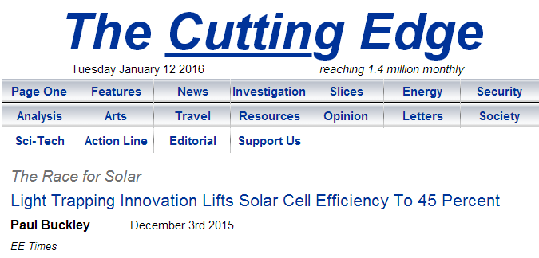
Side Note: Efficiency
η = 1.6 x 10⁻⁵ %

Slide 22
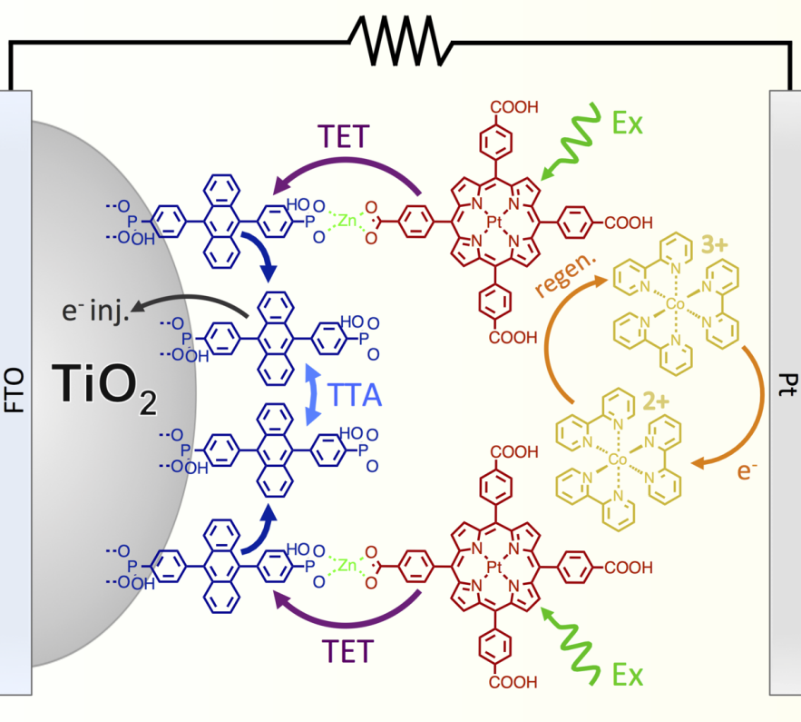
Increasing UC Photocurrent (J_{UC})
JPC Lett., 2018, 9, 5810
9 μA/cm²
ACS Energy Lett. 2016, 1, 3-8.

Slide 23
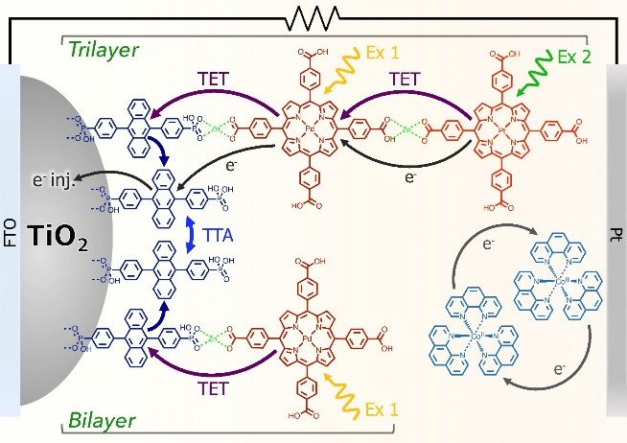
Increasing UC Photocurrent (J_{UC})
JPC Lett., 2018, 9, 5810
78 μA/cm²
J. Mater. Chem. A, 2017, 5, 11652-11660.
9 μA/cm²
ACS Energy Lett. 2016, 1, 3-8.

Slide 24
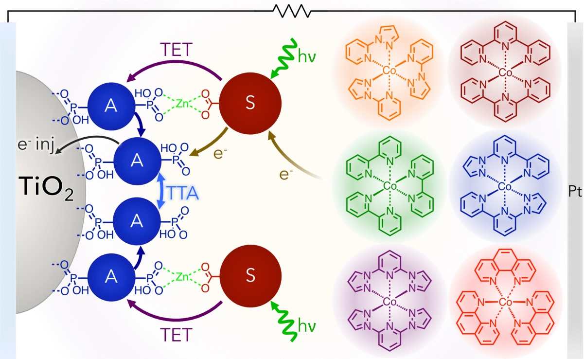
Increasing UC Photocurrent (J_{UC})
JPC Lett., 2018, 9, 5810
158 μA/cm²
JACS 2017 , 139, 10988.

Slide 25
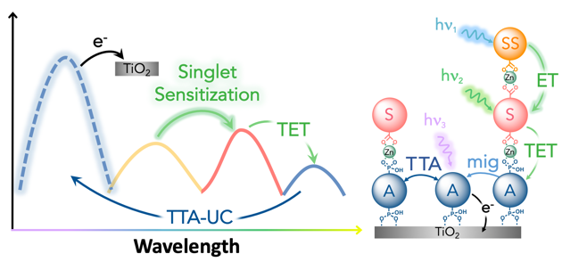
Increasing UC Photocurrent (J_{UC})
JPC Lett., 2018, 9, 5810
ACS Energy Lett. 2019, 4, 1458.
315 μA/cm²
158 μA/cm²
JACS 2017 , 139, 10988.

Slide 26
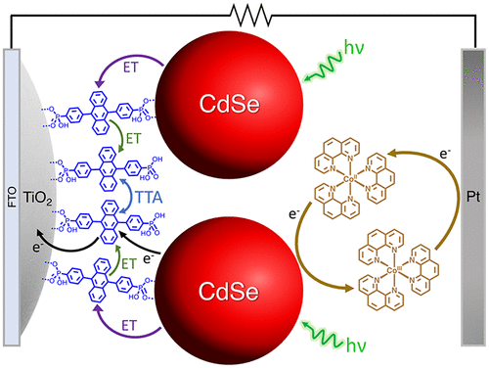
Increasing UC Photocurrent (J_{UC})
JPC Lett., 2018, 9, 5810
29 μA/cm²
ACS Appl. Energy Mater. 2020, 3, 29.

Slide 27
Increasing UC Photocurrent (J_{UC})
JPC Lett., 2018, 9, 5810
JPC C 2020, 43, 23597.
12 μA/cm²
29 μA/cm²
ACS Appl. Energy Mater. 2020, 3, 29.

Slide 28
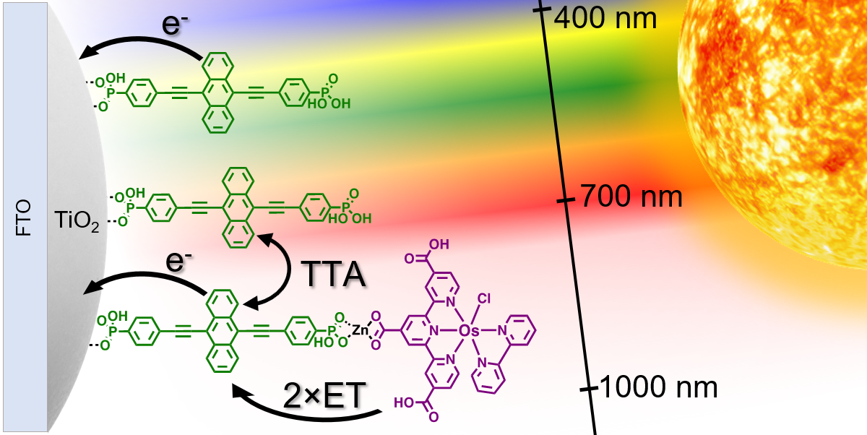
Increasing UC Photocurrent (J_{UC})
JPC Lett., 2018, 9, 5810
JPC C 2020, 43, 23597.
12 μA/cm²
3.5 μA/cm²
29 μA/cm²
ACS Appl. Energy Mater. 2020, 3, 29.
JMC C 2022, 10, 4947.

Slide 29
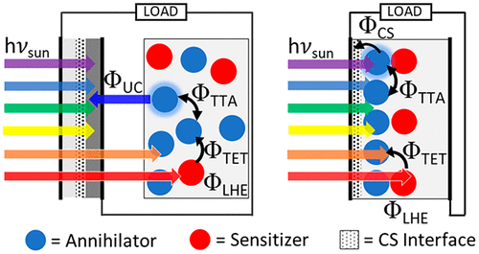
Increasing UC Photocurrent (J_{UC})
JPC Lett., 2018, 9, 5810
Performance Limitations:
ACS AM&I 2021, 13, 32601.

Slide 30
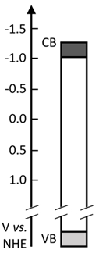
Energy and Electron Transfer
Upconversion Trilayer
¹A*
k_{BET2}
k_{inj(}1_{A*)}
k_{BET1}
¹F*
k_{inj(S*)}
¹S*
k_{ET1}
k_{inj(}3_{A*)}
γ_{TTA}
k_{ISC}
k_{BTET}
³F*
k_{mig}
k_{TET}
³S*
k_{r(F*)}
k_{BeT1}
³A*
k_{ex(S)}
k_{r(}1_{A*)}
k_{r(}3_{S*)}
k_{ex(F)}
k_{nr(F*)}
k_{nr(}1_{A*)}
k_{nr(}3_{S*)}
k_{nr(}3_{A*)}
k_{BeT2}
k_{et}
k_{et}
¹F
¹A
¹S
Glass
TiO₂
e⁻ Acceptor
Annihilator
Triplet Sensitizer
Singlet Sensitizer
ACS Energy Lett. 2019, 4, 6, 1458

Slide 31
Energy and Electron Transfer
Upconversion Trilayer
Photosynthesis
¹A*
k_{BET2}
4.4x10⁹
k_{inj(}1_{A*)}
4.5x10¹¹
k_{BET1}
1.9x10⁷
¹F*
k_{inj(S*)}
1.6x10⁶
¹S*
k_{ET1}
3x10¹¹
k_{inj(}3_{A*)}
1.6x10⁶
γ_{TTA}
1.0x10⁻¹⁵
k_{ISC} >10¹²
k_{BTET}
~0
³F*
k_{mig}
k_{TET}
1.3x10⁴
³S*
k_{r(F*)}
5.9x10⁸
k_{BeT1}
9.5x10⁶
³A*
k_{ex(S)}
>10¹⁵
k_{r(}1_{A*)}
2.5x10⁸
k_{r(}3_{S*)}
2.5x10²
k_{ex(F)}
>10¹⁵
k_{nr(F*)}
5.8x10⁸
k_{nr(}1_{A*)}
2.3x10⁸
k_{nr(}3_{S*)}
1.7x10⁴
k_{nr(}3_{A*)}
4.9x10³
k_{BeT2}
5.5x10⁶
k_{et}
<10⁶
k_{et}
<10⁶
¹F
¹A
¹S
Glass
TiO₂
e⁻ Acceptor
Annihilator
Triplet Sensitizer
Singlet Sensitizer
ACS Energy Lett. 2019, 4, 6, 1458
https://doi.org/10.48550/arXiv.1608.06913

Slide 32
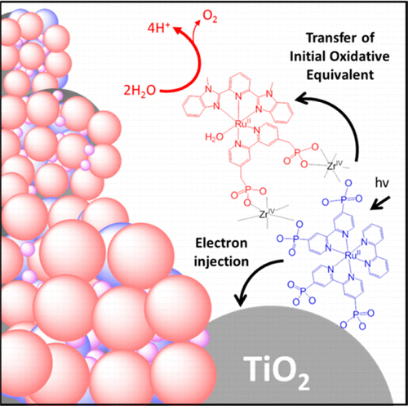
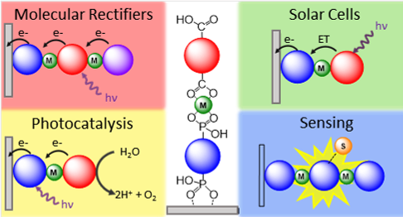
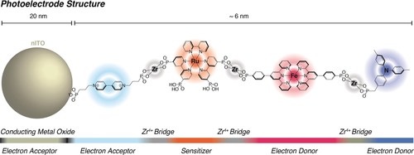
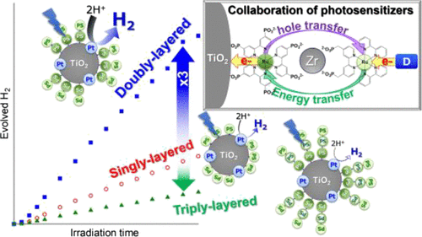
Metal Ion Linked Multilayer Structure
Water Oxidation DSPEC
Energy/Electron Transfer Cascade
ACS AM&I 2016, 8, 28633
Chem. Sci. 2021, 12, 50.
Molecular Rectifiers
H₂ Generation
ACS Appl. Opt. Mater. 2023, 1, 1156.
Angew. Chemie. 2018, 57, 15390.
ACS Omega, 2017, 2, 3901.
Notes:
Kato out of Hokkaido University

Slide 33
Bilayer Structure
What is known:
Not co-deposition
Metal-ion coordination
Directional E/e⁻ transfer
What is not known:
Surface binding angle
Relative orientation
Controllability

Slide 34
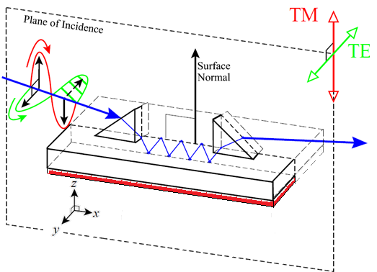

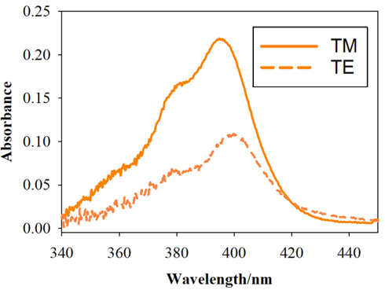
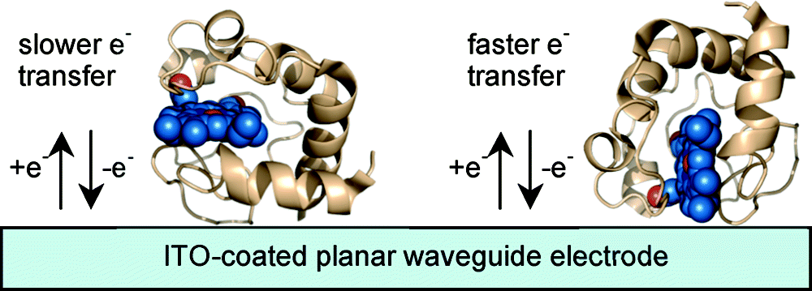
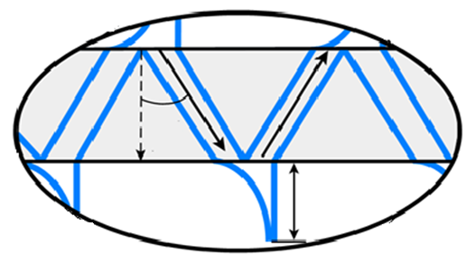


Polarized Attenuated Total Reflectance
Prof. Scott Saavedra at UofA:
Measure A_{TE} and A_{TM}
Dichroic ratio $ρ=\frac{A_{TE}}{A_{TM}}$
ITO coated glass substrate
Calculate mean tilt angle$θ$
monolayer
JACS 2008, 130, 5, 1572
Evanescent wave
John Thomas Bradshaw , A. PhD. Dissertation, University of Arizona, 2005

Slide 35
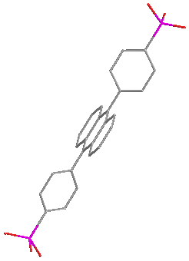
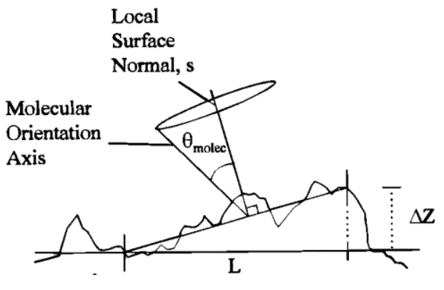
Metal Oxide-Anthracene Structure
ZrO_{2,} Al₂O₃
38º
37º
44º
30º
CB
e⁻
S₁
e⁻
CB
TiO₂
TiO₂
ZrO₂
Al₂O₃
ITO
Roughness:
1.2±0.4nm
1.1±0.3nm
2.2±0.5nm
0.5±0.1 nm
E
ITO
S₀
e⁻
VB
@0 nm roughness, tilt angle = 22º
Rowlen et al. JPC C 1999, 103, 1525.

Slide 36
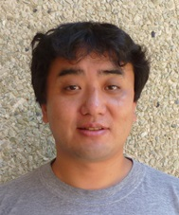
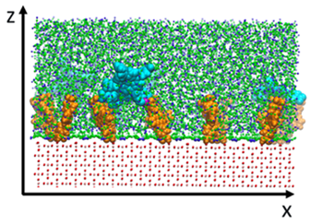
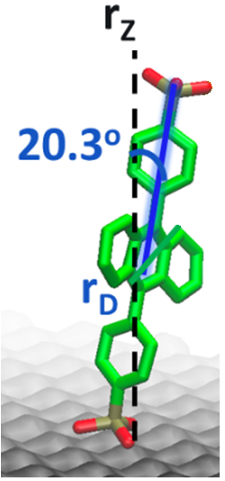
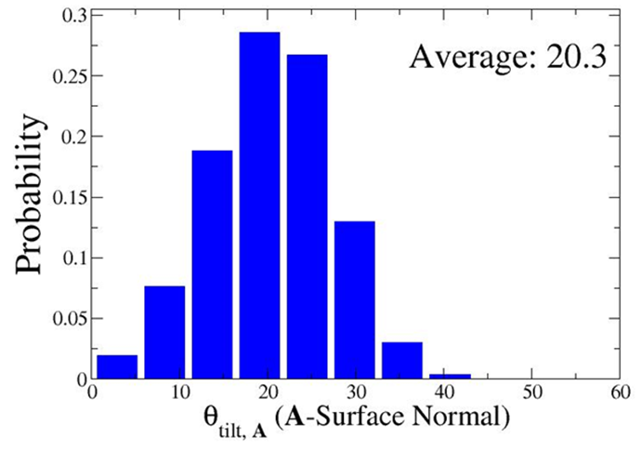
Metal Oxide-Anthracene Structure
ZrO_{2,} Al₂O₃
38º
37º
44º
30º
CB
e⁻
S₁
e⁻
CB
TiO₂
TiO₂
ZrO₂
Al₂O₃
ITO
Roughness:
1.2±0.4nm
1.1±0.3nm
2.2±0.5nm
0.5±0.1 nm
E
Prof. Wei Yang at FSU:
ITO
S₀
e⁻
VB
@0 nm roughness, tilt angle = 22º

Slide 37
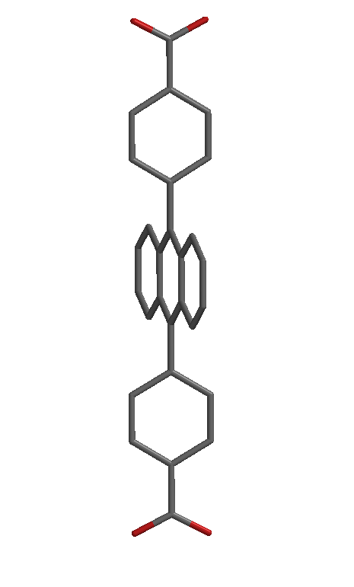
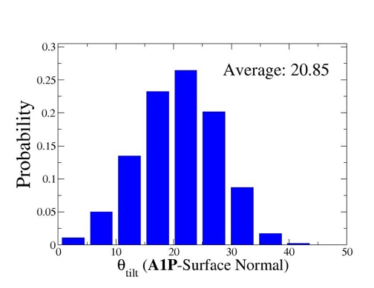
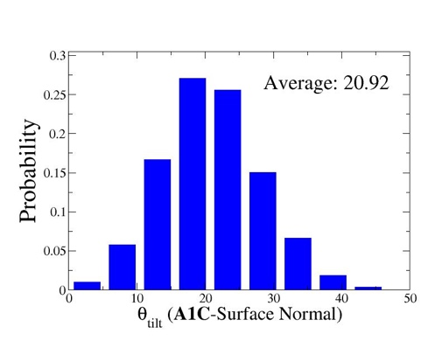
Metal Oxide-Anthracene Structure
ZrO_{2,} Al₂O₃
38º
37º
44º
30º
CB
e⁻
S₁
e⁻
CB
TiO₂
TiO₂
ZrO₂
Al₂O₃
ITO
Roughness:
1.2±0.4nm
1.1±0.3nm
2.2±0.5nm
0.5±0.1 nm
Similar angle regardless of metal oxide.
Binding group does not impact angle.
Orientation dictated by molecular structure/packing.
E
ITO
S₀
e⁻
VB
30º
31º
PO₃H₂ vs COOH
ITO
ITO

Slide 38


Multilayer Structure
Zn
37º
40º
Zn
Zn
Zn
31º
33º
38º
38º
ITO
ITO
ITO
ITO
ITO

Slide 39

Multilayer Structure
First multi-chromohore by ATR.
Subsequent metal ion and layer addition has minimal effect on the binding angle.
75º
Zn
Zn
37º
40º
40º
FRET
Zn
Zn
Zn
Zn
31º
33º
38º
38º
39º
ITO
ITO
ITO
ITO
ITO
ITO

Slide 40


Structure and Energy Transfer
ZrO₂-F
ZrO₂-P-Zn-F
ex 475 nm
ex 475 nm
F
FRET
P
ZrO₂-P
ex 455 nm
$$k_{ET}=\frac{1}{τ_{bilayer}}−\frac{1}{τ_{P}}$$
ZrO₂
k_{ET} = 3×10¹¹ s⁻¹
$\text{F}FRET$≈ 100%

Slide 41









Structure and Energy Transfer
$$\text{F}FRET=\frac{1}{{1+\left(\frac{r}{R_{0}}\right)}^{6}}$$
$ϕ_{D}$= fluorescence QY of F
n = refractive index
J = overlap integral
κ² = orientation factor
r = distance between F and P
F
$$R_{0}=9780{\left. [J{ ϕ}_{D}{ n}^{−4}{\text{κ}}^{2}\right]}^{1/6}$$
FRET
P
$\text{F}FRET(calc)=$ >99% >99% >99% >99% >99%
$$k_{ET}=\frac{1}{τ_{bilayer}}−\frac{1}{τ_{P}}$$
ZrO₂
k_{ET} = 3×10¹¹ s⁻¹
$\text{F}FRET$ ≈ 100%

Slide 42
Moving Forward: Controlling Energy Transfer
JPC C 2020, 124, 23597.
41º
50º
JPC C 2018, 122, 9835.
Langmuir 2017, 33, 9609.
ET
Cd^{II} Cu^{II} Fe^{II} La^{III} Mn^{II} Sn^{IV} Zr^{IV} Zn^{II}
Zn
ET
La
38º
36º
JPE 2017, 8, 022004.
PCCP 2018, 20, 20513.
ITO
ITO
k_{ET} = 5.8×10¹⁰ s⁻¹
k_{ET} = 3.4×10¹⁰ s⁻¹
MO₂

Slide 43


Moving Forward: Controlling Structure
Molecular Switches
Inhibiting Distortion

Slide 44





Inhibiting Distortion
Steric Bulk
Strategic Surface Binding
hν
τ = 2800 ns
Φ = 6.3%
τ = 90 ns
Φ = 0.04%
hν
J. Phys. Chem. A 2015, 119, 13, 3181–3193

Slide 45
Strategic Surface Binding
Constable et al. Dalton Trans. 2009, 6634
1
2
3

Slide 46
Transient Absorption
1
2
3
λ_{abs} = 690 nm
In MeOH
λ_{ex} = 500 nm
On ZrO₂ in MeOH
λ_{ex} = 500 nm

Slide 47
Decay Kinetics
1
2
3

Slide 48
Strategic Surface Binding
τ = ×5
τ = ×7
τ = ×20
1
2
3

Slide 49

Moving Forward: Controlling Structure
Molecular Switches
Inhibiting Distortion
Atomic Layer Deposition

Slide 50






Controlling Intermolecular Interactions
Up-Conversion
Atomic Layer Deposition
Beery, D. et al. J. Mater. Chem. C. 2022.
Excimer Emission
Knorr et. al. Molecules 2023, 28, 4835.
Emission
Transient Absorption
Myong, M. S., et al. J. Phys. Chem. C. 2021.
Singlet Fission
Bae, Y. J., et al. J. Am. Chem. Soc. 2018.

Slide 51

Conclusions
TTA-UC Emission
On ZrO₂: Blue to green upconversion
Quadratic to Linear Behavior
TTA-UC Solar Cell
Improvements with component selection
J_{UC} up to 315 μA/cm²
Structure matters
Determine Structure (polarized ATR)
1st layer orientation is MO_{x} independent
2nd layer dependent on metal and binding group
Reasonable agreement between ATR and Theory (MM)
Efforts to Control Structure are underway

Slide 52




Other Projects
ES Proton Transfer Catalysis/Enrichment
H₂ Generation Z-Scheme
50:50, R:S BINOL
Boc-D-Proline
68% de
86% yield
Photomechanical Polymers
Using IRT and CCT to Analyze Exams
hυ
hυ

Slide 53




Acknowledgements
Not Pictured Contributors
Dr. Sean Hill
Dr. Tristan Dilbeck
Dr. Yan Zhou
Dr. Drake Beery
Cory Ruchlin (McGill)
Jonathan Wheeler (NCSU)
Cody Basquill (FSU)
Ethan Lambert (FSU)
Dominic Willadsen (REU)
Collaborators
Dr. Raaj Winfred
Dr. Wei Yang
Dr. Scott Saavedra

Slide 54









Questions?
@HansonFSU

